Slide 1
caArray User Community Meeting
1.x Update and 2.0 Development Status
Call in: 877-416-5524
Participant Passcode: 2627056
Centra: http://ncicb.centra.com
Meeting ID: array_aug8
August 8, 2007

Slide 2
Agenda
Recent Releases
  1.5.0.1
Upcoming Releases
  1.5.0.2
  1.6
  Grid service on Production
  Data parsing
2.0 Update
  Where we are
  What are the expected results
  What we need from the user community

Slide 3
caArray 1.5.0.1 – Patch Release
Released July 3
Fixed a poor performing public Array search

Slide 4
caArray 1.5.0.2 – Patch Release
We are currently planning for a patch release to fix the association between DerivedBioAssay, MeasuredBioAssayData, DerivedBioAssayData, and Experiment
  Affects users of the MAGE-OM API
This patch will be provided with a patch installer
  Upgrading will not require rebuilding the application
  GUI Driven
To be released in approximately two weeks

Slide 5
Grid service
The 1.5 grid service has not been released to Production, but is available on our Staging (pre-production) server
caB2B team has been using the grid service extensively and we have made client-side fixes based on their feedback
We plan to release the grid service to Production within the next two weeks, pending resolution on one additional issue (GForge # 8106)

Slide 6
caArray 1.6 – Maintenance Release
To be released at the end of September
Items addressed include:
  A number of issues that have been identified when loading MAGE-ML files that have been created from MAGE-TAB files using the EBI’s Tab2MAGE converter
  Evaluate removal of partitioning in the database
  Annotation error for existing file in an Experiment
  Performance of adding and updating Sources
  Messaging to user for status of array design parsing
  Sample extract characteristics searches

Slide 7
Data Parsing
We will be incrementally parsing data into the Production instance of caArray
  Data that is parsed into the database is available as a BioDataCube through the MAGE-OM API
We will update the community on the data loading progress at these meetings

Slide 8
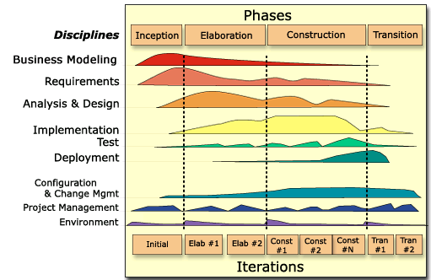
caArray 2.0 - Where We Are
2.0 Elaboration Iteration 1
  Completed 7/27
  Non-UI focused
  Domain Object Model Prepared
  MAGE-TAB able to be loaded, imported and extracted through API
2.0 Elaboration Iteration 2
  Validation to be incorporated
  Non-Affy and SNP parsers to be added
  Grid a significant focus

Slide 9
Results of Elaboration Iteration 1
Project Management:
  Refine 2.0 Schedule, Detail E2 Schedule
Requirements:
  Wrote prioritized Use Cases
  Established Community Reviewers of major functional areas
Analysis and Design
  Strategy for Parsing, Validation, Binary Storage
Implementation
  Prepared architectural proof of Upload, Import and Extraction
Environment
  Began preparation for automated deployments to increase ability to serve you with quicker releases

Slide 10
Goals of Elaboration Iteration 2
Project Management
  Refine 2.0 Schedule, Detail C1 Schedule
Requirements
  Continue to gather and incorporate feedback on Use Cases from community members
  Write additional UC’s Manage Project Permissions
  Create wireframes for targeted UCs; overall user interface design
Analysis and Design
  Finalize domain object model (Titled “Logical” in caArray_caCORE.eap – available also as html)
  Targeted UC A&D – Validation, Permissions
Implementation
  Complete MAGE-TAB parsing
  Grid service
  Validation, Security
Test
  Build Test Data from Community
  Automate Tests as we build

Slide 11
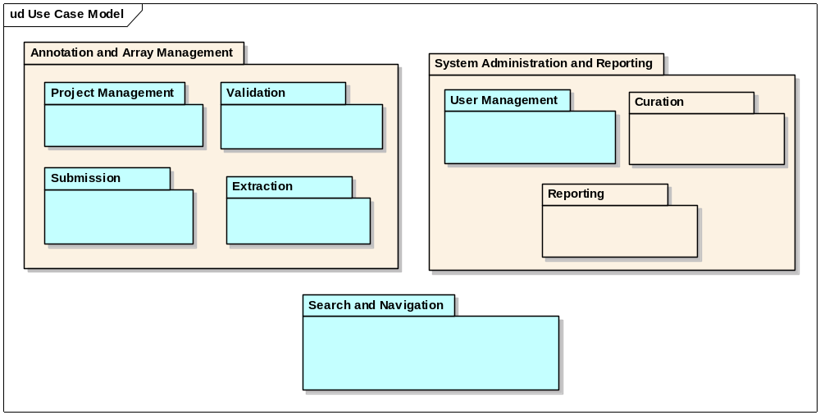
2.0 Use Case Model

Slide 12
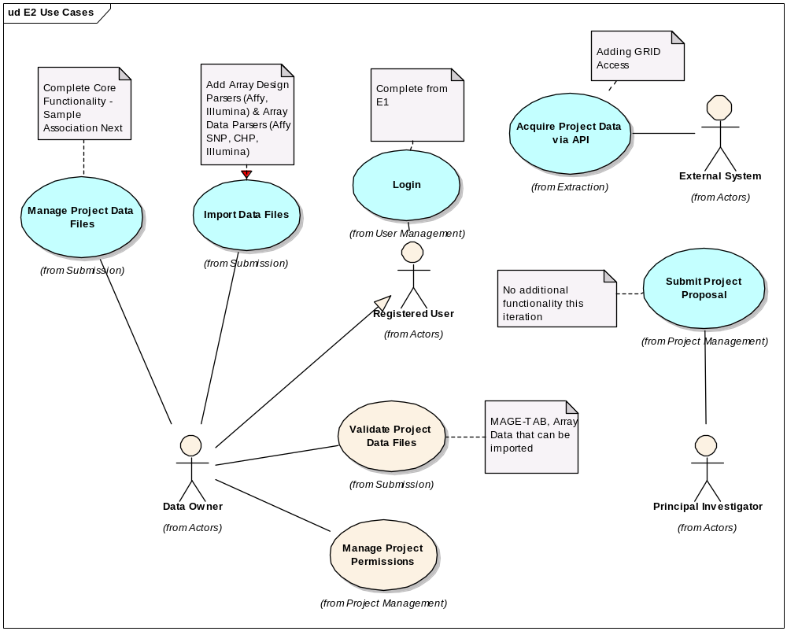
E2 Use Case Model and Activities

Slide 13
Specific Questions
Terms to use for logical organization of work/data
  “Project” vs. “Experiment” vs. other to represent a single thread of work?
  “Program” vs. “Study” vs. other to describe a group of the above within a lab, across labs or even across institutions?
Are there additional SNP study types outside of copy number analysis, loss of heterozygosity, genotyping, and whole genome association?
Are there differences between how you would search for gene expression projects vs SNP projects?
Should native files be made available through the API?

Slide 14
Specific Questions Continued
Should we restrict the ability to change a “Project’s” permissions once a manuscript is published against the data included to only allow for new data to be controlled?
Should only a PI be able to make a “Project” public?
Should we add a project type called “reference” to allow for the availability of a set of say “normal” data to be reused from Project to Project?
Would you allow external institutions to use that data for their own projects (if you both were on the Grid or you allowed collaborators access through the management of permissions?)

Slide 15
What we need from you and when
Initial priority acquired – thank you
Initial feedback on priority use cases – thank you
Next round of feedback
  Logical model – overview to be presented at Friday’s Analytical Services Best Practices meeting (8/10/07, 2:00pm ET)
  Updated use cases
In September
    Wireframes and UI Concepts
    Then Search and Repository Navigation -

Slide 16
Continuing Engagement Model
Continue Monthly Meetings
G-Forge site for 2.0 is available that indicates needs, features, use cases and test cases
  We will continue to publish regularly and investigate forums and surveys for targeted feedback
G-forge site: https://gforge.nci.nih.gov/projects/caarray2/

Slide 17
Next Steps
Please visit G-Forge: https://gforge.nci.nih.gov/projects/caarray2/ to view the prioritization of features and use cases (Tracker items)
Results of Elaboration Iteration 2 September 6th, 2007
Next meeting date: TBA but anticipated September 12, 2007

